Slide 1
Business Problem
<STARTUP – NAME> Everyone goes to doctor for regular health checkup, they have to remember and make appointments for them.
Sometimes they may forget to take appointments in time due to busy work or some other reason and some may lose previous reports.

Slide 2
Solution (Product/Service)
What solution you proposed ?
– TO solve the problem we can create an app called Health Inspector which will notify the user when there is a need for health checkup and we can take appointment using this app,it also stores the previous records of the patient .

Slide 3
Customer & Customer Validation
Who needs your product?
people who go for regular health checkup are the customers,especially old age people and people who are above 35yrs.

Slide 4
Market (size)
How many customer need this?
All people who go for the regular health checkup.

Slide 5
Competition / Currently solved
Currently the customers are addressing the problem by taking appointments a
week before or a day before .

Slide 6
Unique Value Proposition
How your solution is different from
the existing solutions or products?
1.storing the previous records of patients.
2.Making easy to take Appointments.
3.24/7 online service.

Slide 7
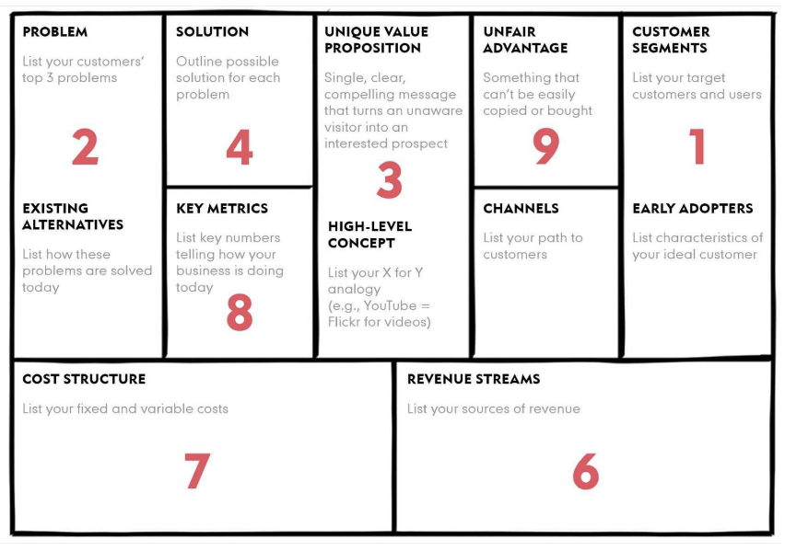
Lean Canvas

Slide 8
KEY METRICS
KEY PARTNERS: Hospitals,Patients,
Medical supply companies.
Key Activities: Linking the hospitals and patients,
Storing the Database of customers.
online Appointments.
KEY RESOURCES: Software
Security.

Slide 9
CHANNELS: Follow up mails
Newspaper adds
Advertising
COST STRUCTURE: Maintaince(Equipments)
Employees
Marketing

Slide 10


Thank You!

